Slide 1
Successful Applications of Domain Driven Design in Java

Slide 2
Agenda
1. What is DDD? Why?
2. Relations of DDD with Other Architectures & Patterns
3. Strategic Design
4. Tactical Design
5. Event Storming
6. Sample Project Structure in Spring Boot

Slide 3
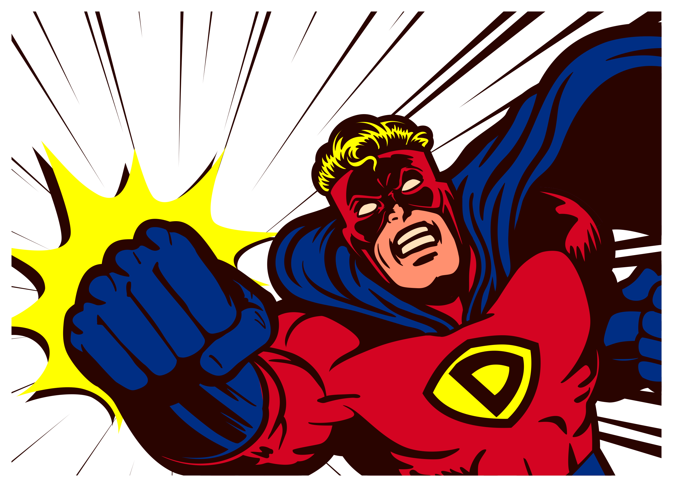
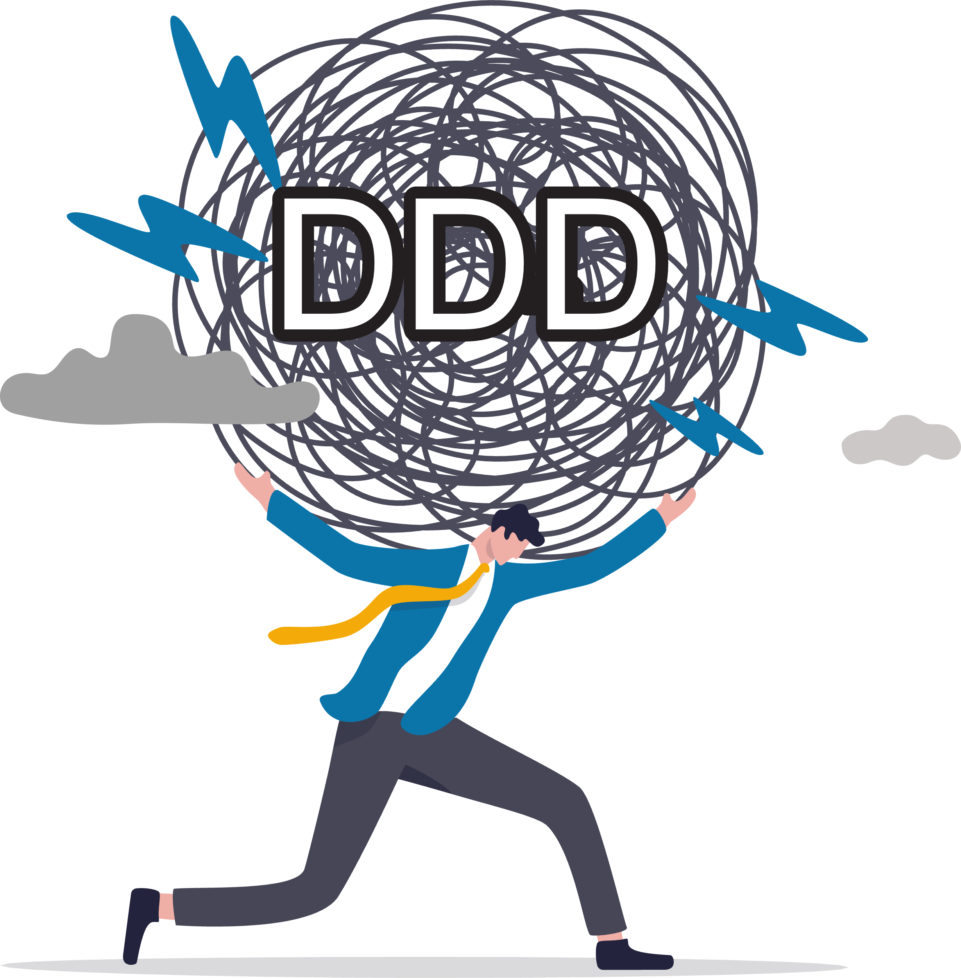

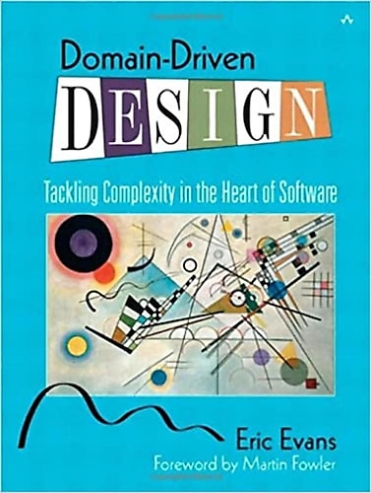
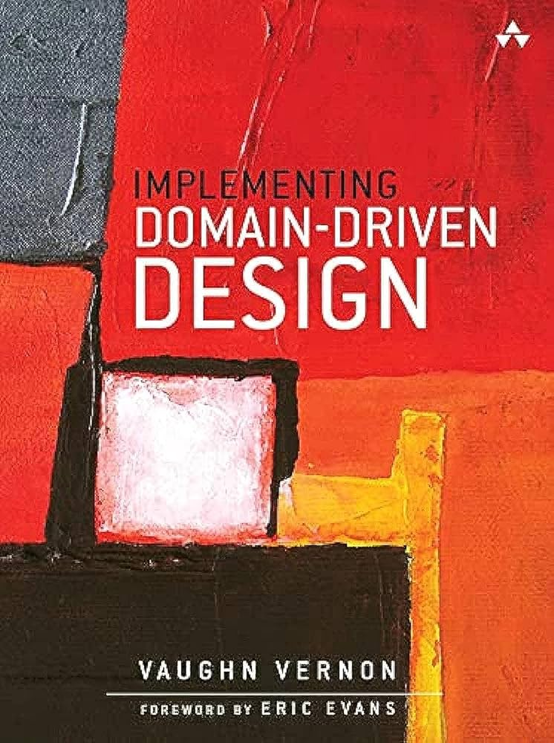

1. What is DDD? Why?
2003
2013

Slide 4



1. What is DDD? Why?
Software Development approach for designing COMPLEX businesses

Slide 5

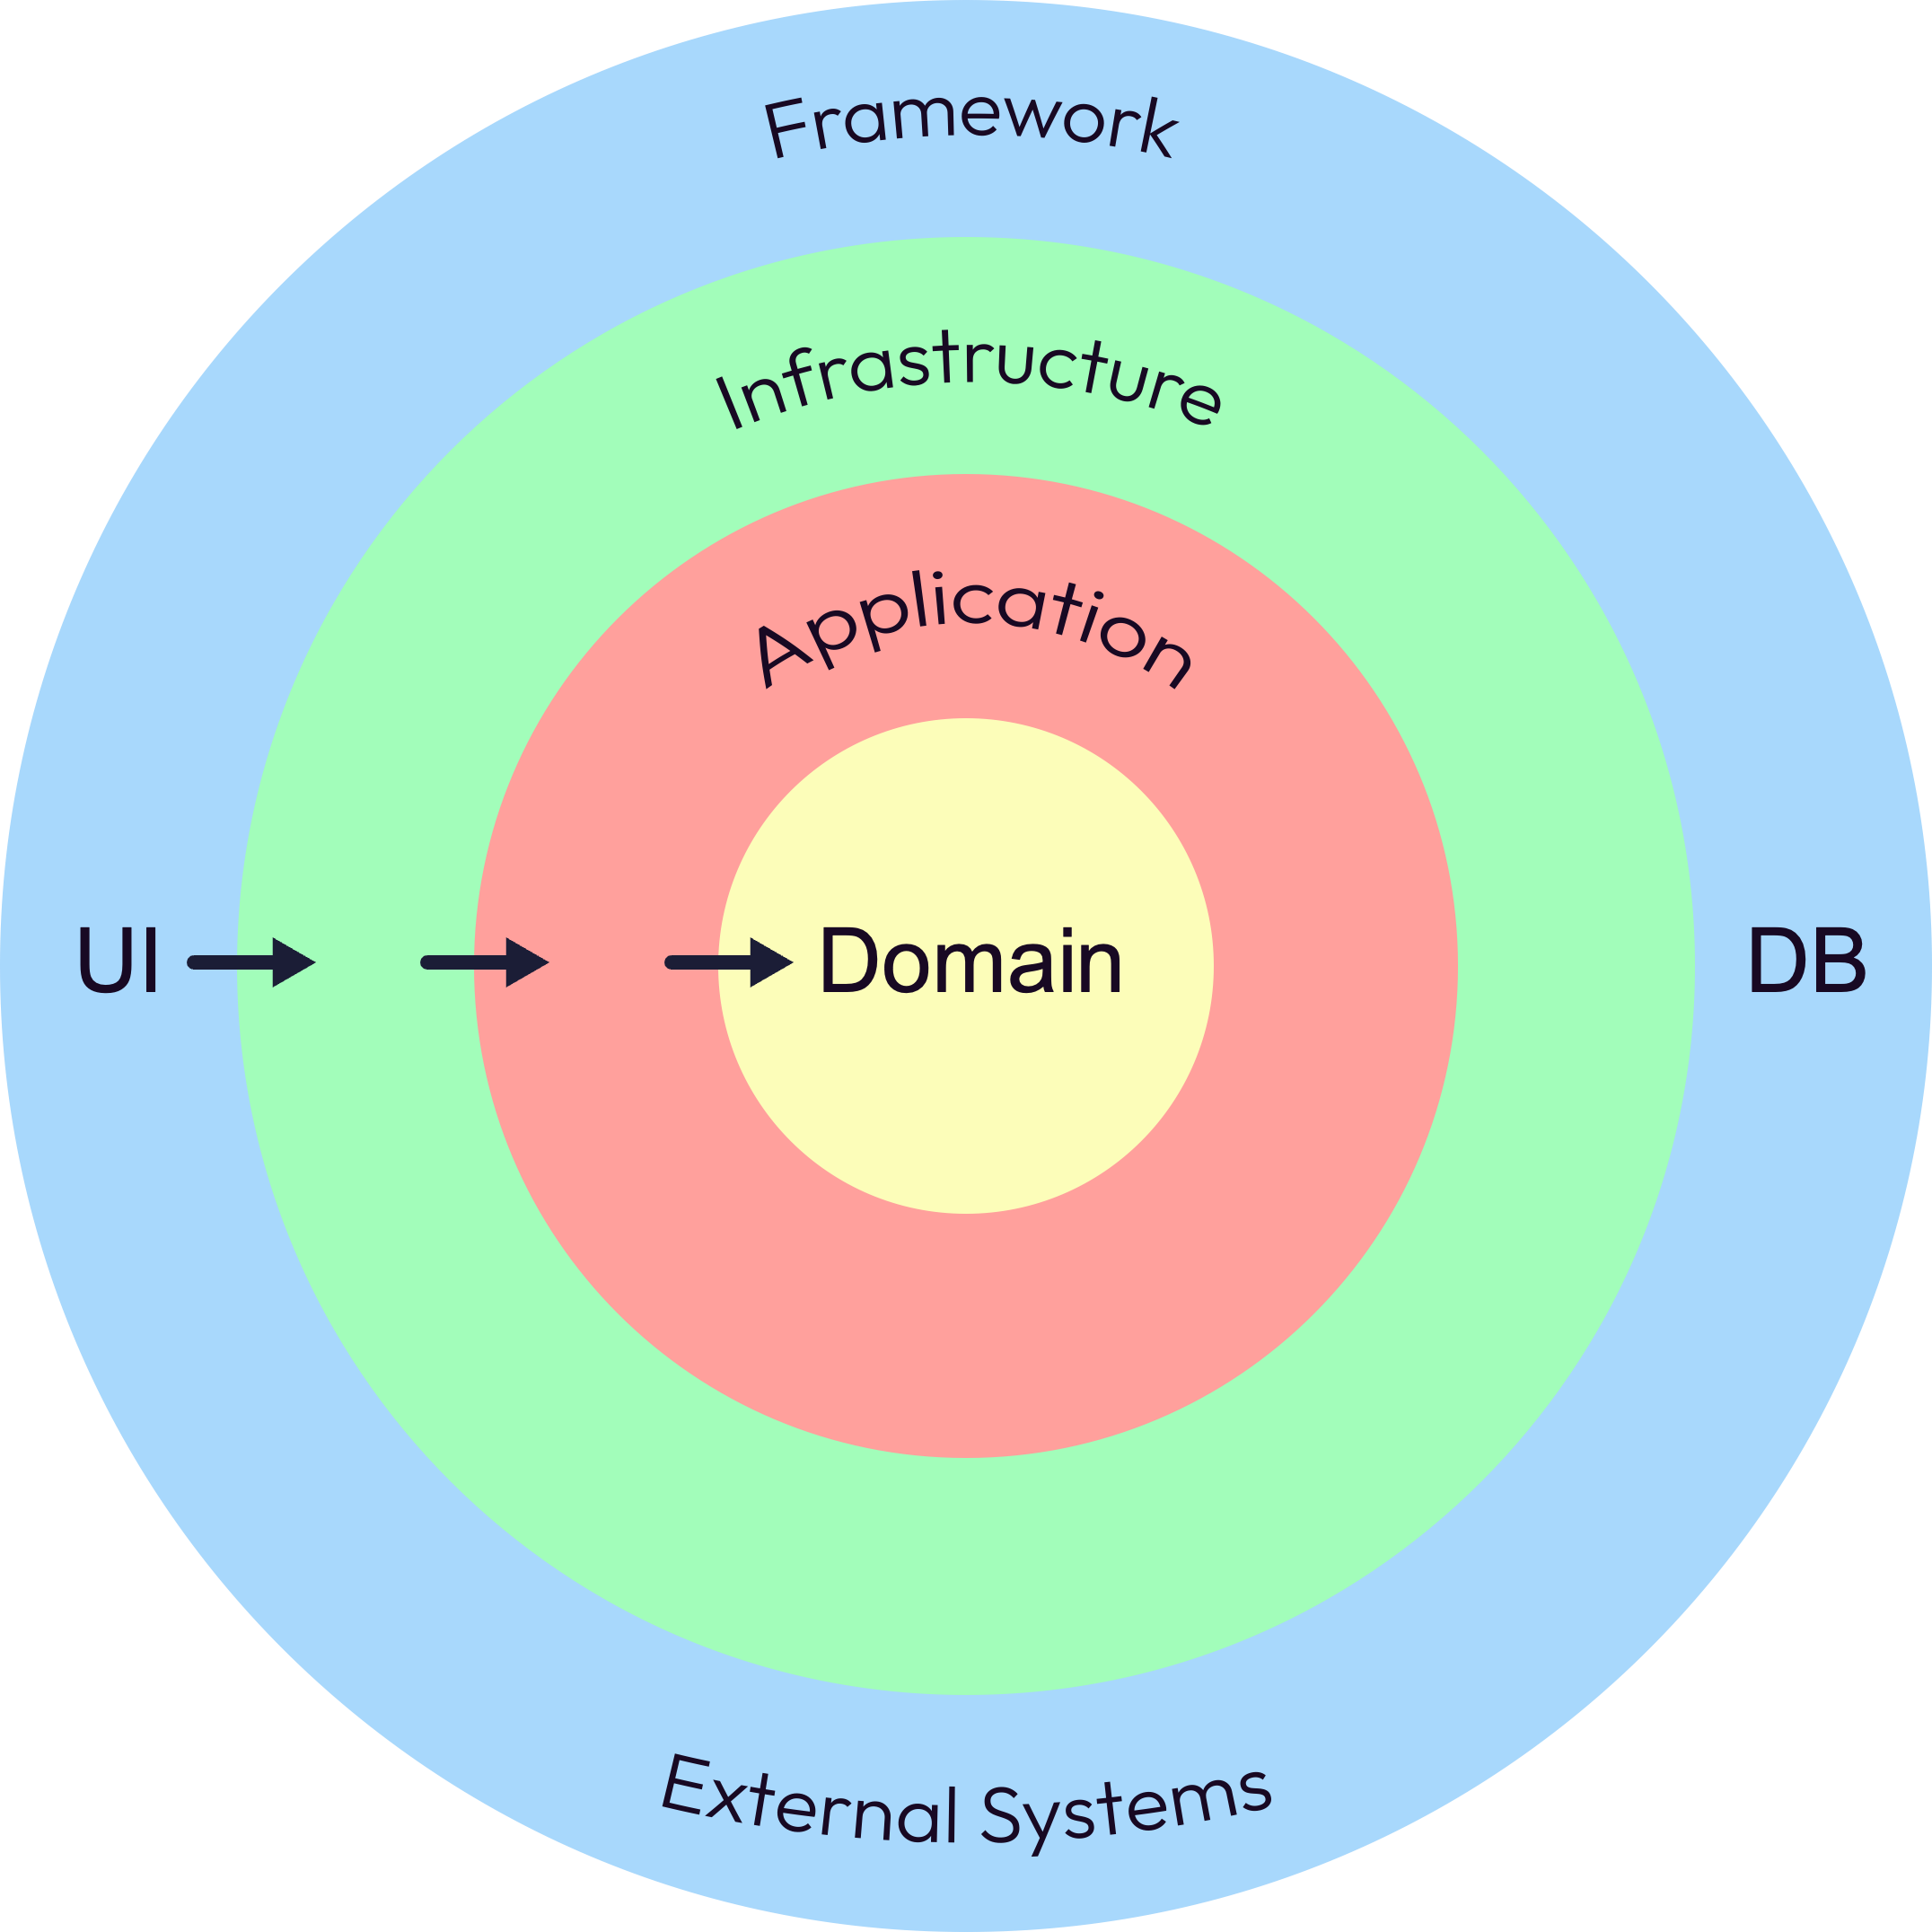
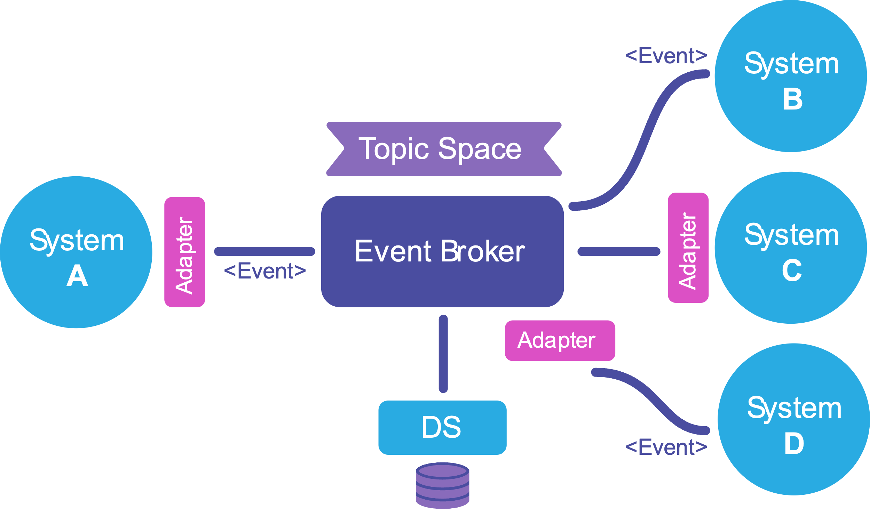
2. Relations of DDD with Other Architectures & Patterns
Clean / Hexagonal / Onion Architecture
Ports & Adapters Design Pattern
Microservice
Architecture
Event Driven
Architecture

Slide 6
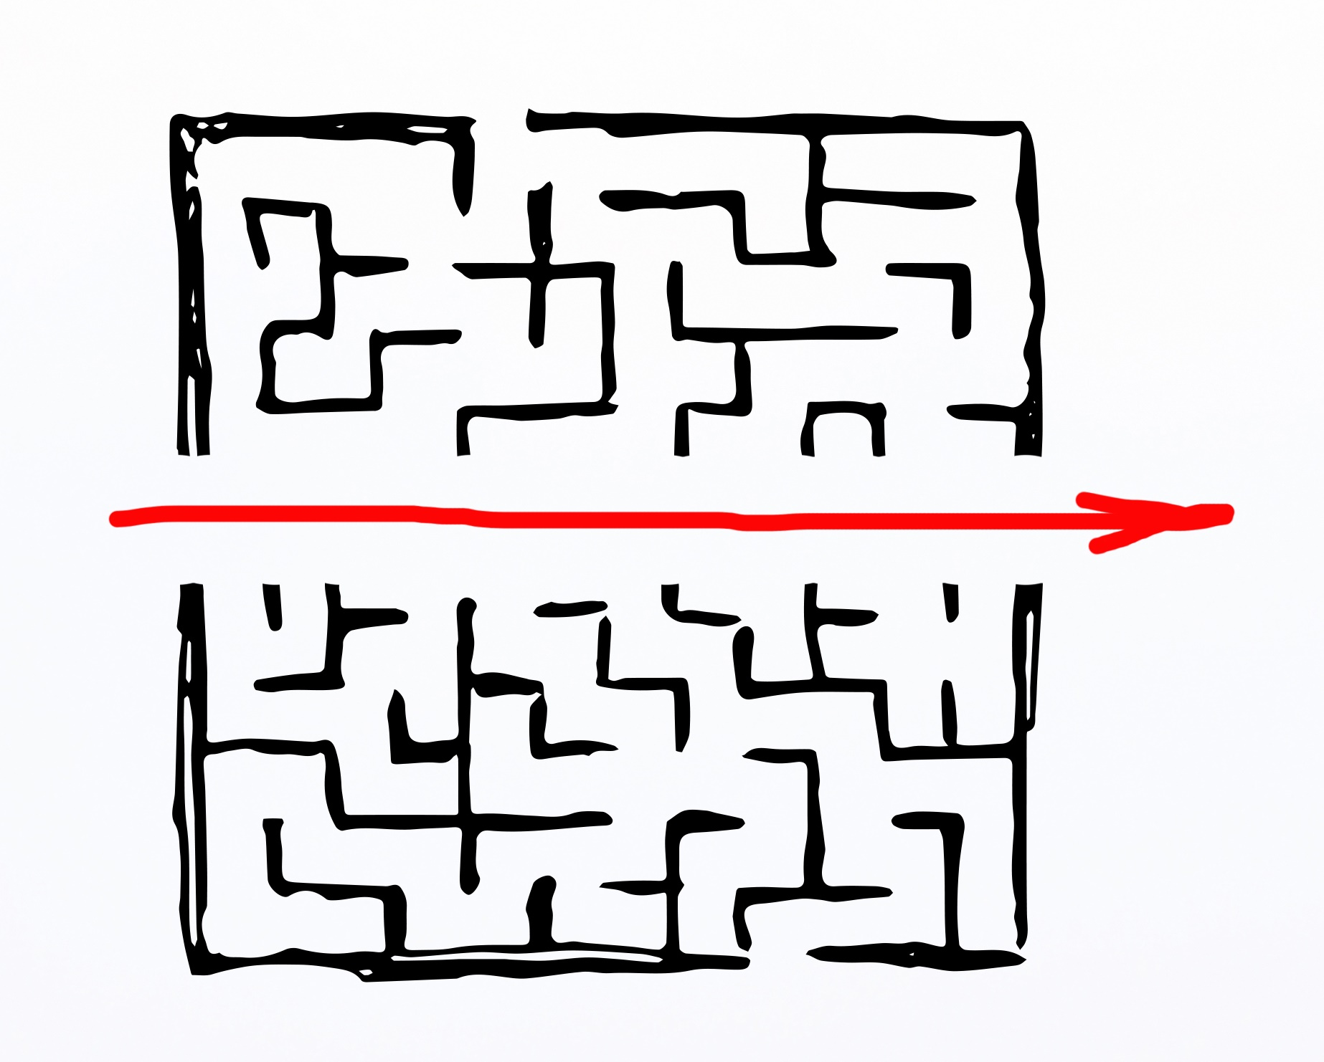

3. Strategic Design
PROBLEM SPACE
SUPPORTING
SUBDOMAIN
MONEY
MAKER
GENERIC
SUBDOMAIN

Slide 7
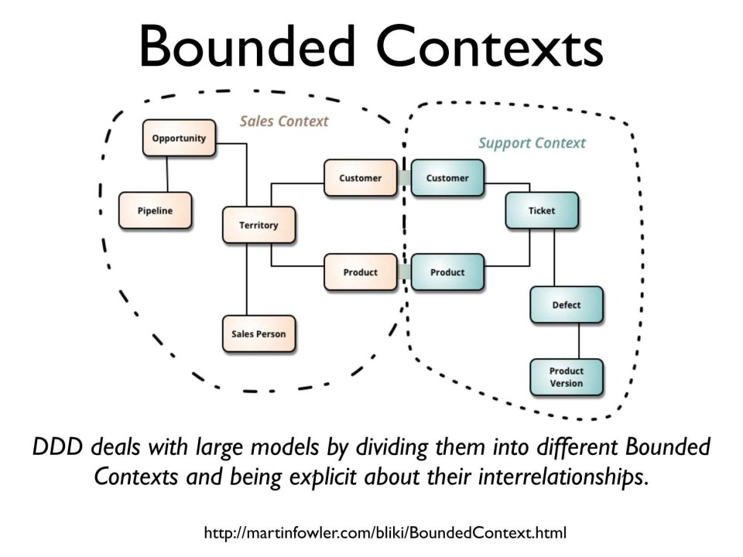
3. Strategic Design – Bounded Context

Slide 8

3. Strategic Design – Ubiquitous Language
Ubiquitous Language?
A language structured around the domain model and used by all team members to connect the activities of the team with the software.
Amount
Price
Credit
Bill
Cash
Total
Money

Slide 9
4. Tactical Design – Entity vs Value Object
Entity vs Value Object
Characteristic | Value Object | Entity
Mutability | Should be immutable | Usually mutable
Equality | Compare by value, as in a.equals(b) | Compare by identity, as in a==b
Scale | Typically small in scale | Of any size
Serializability | Should be serializable; may be parseable | Need not be serializable
Defaults | Often have a natural default: the number 0, or "today >> | No natural default
Comparability | Often have a natural order: 1, 2, 3... | Typically no natural sort order
Closure (or Algebra) | Often have a closed set of operations: 2+2=4 | Unlikely to have any closed set of operations
Identity | May represent an identifier, such as an SSN | Something that is identi- fied, such as a Person
User Interface | Have dedicated widgets: checkbox, calendar... | Coded by hand

Slide 10
4. Tactical Design – Aggregate Root
Shipment
Aggregate Root
1
1
1
Aggregate Boundary
1
1
Sender
Receiver
1
1
Warehouse
1
m
m
Items

Slide 11










5. Event Storming
LEGENDS
Actor
Command
Constraints
&
Validations
Event
System
Policy
Not Clear

Slide 12

5. Event Storming - Sessions
Defining Events
Events Refinement & Ordering
Actors, Commands, Contraints & Event relations with help of Policy, System & Not Clear legends

Slide 13


6. Sample Project Structure in Spring Boot
BEST PRACTICES
V

Slide 14
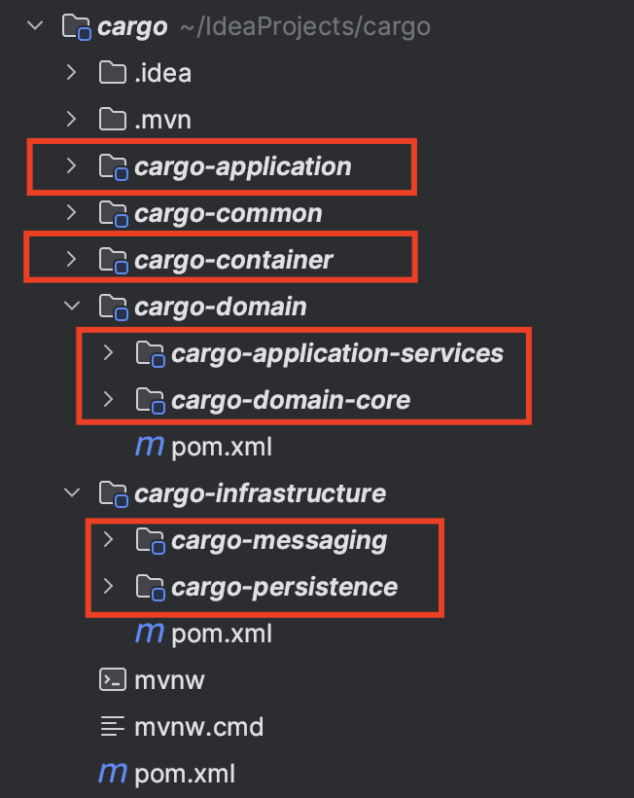
6. Sample Project Structure in Spring Boot
Best Practice: DDD Spring Boot Application - Modules
container
messaging
application
application-services
persistence
domain-core

Slide 15
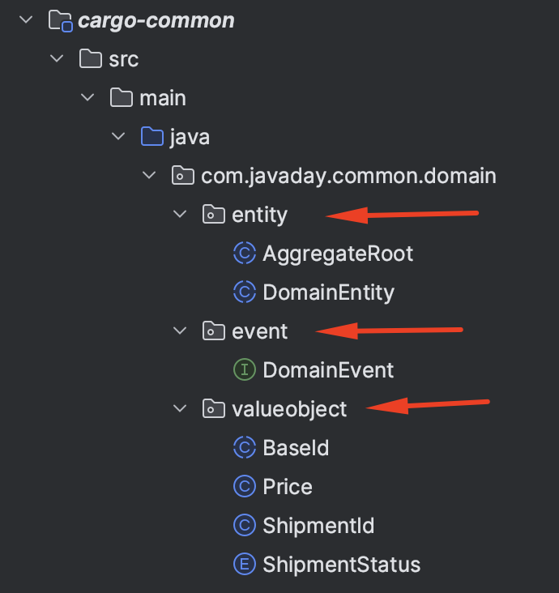
6. Sample Project Structure in Spring Boot
Tactical Design in Common
Aggregate Root
Entity
Value Object
Event

Slide 16
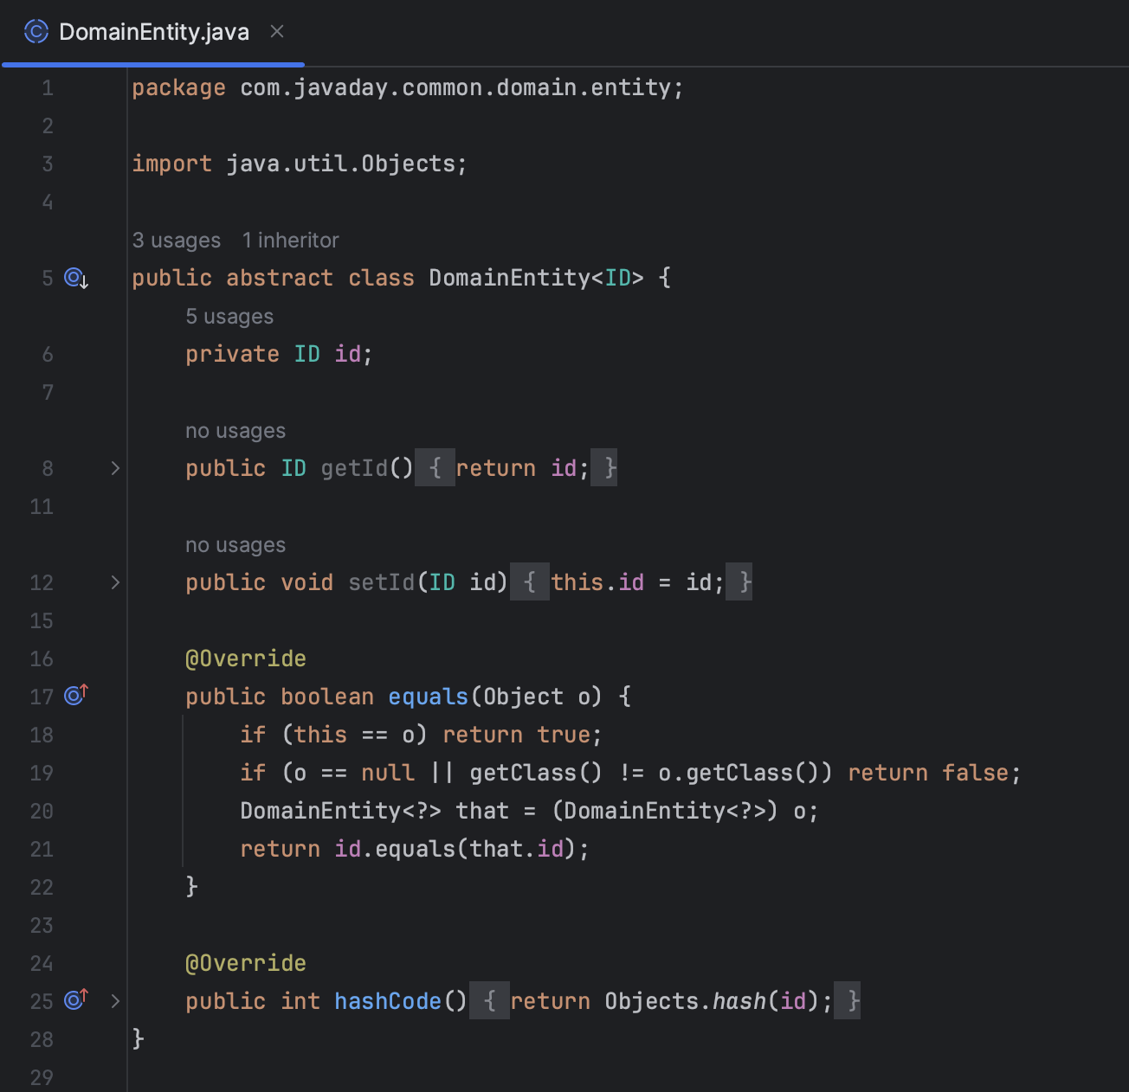
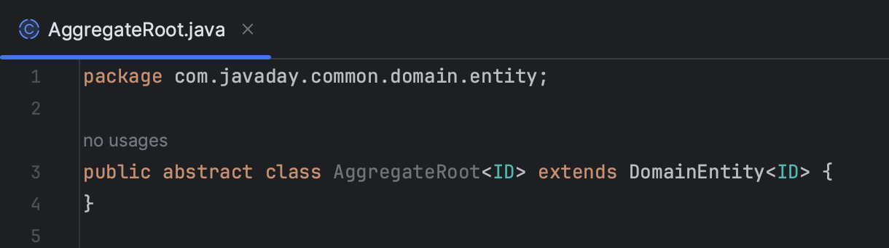
6. Sample Project Structure in Spring Boot
Aggregate Root – Entity

Slide 17
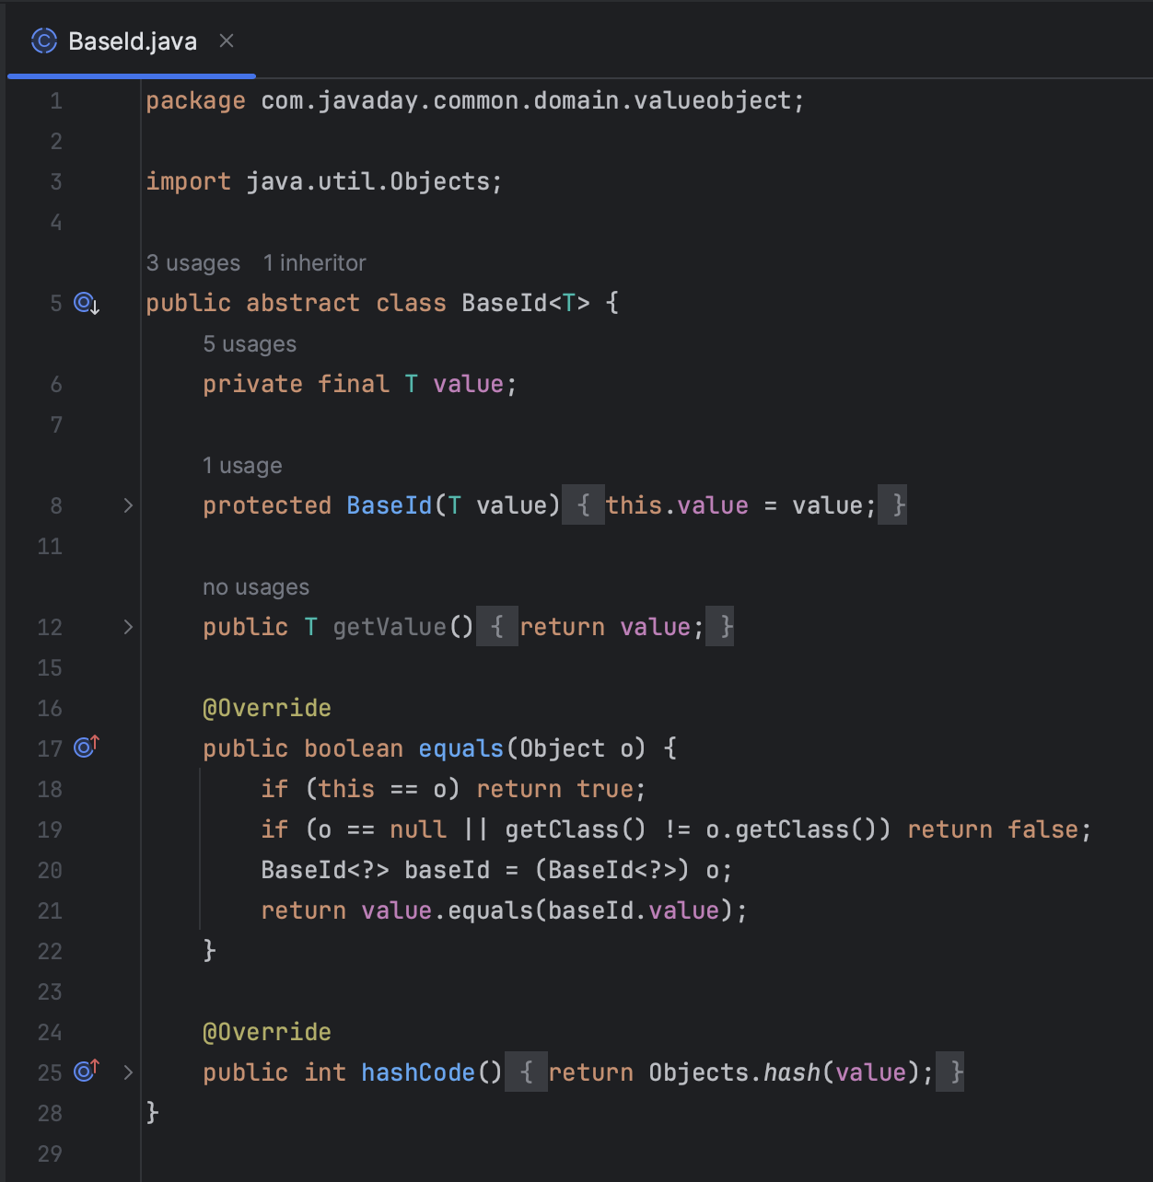
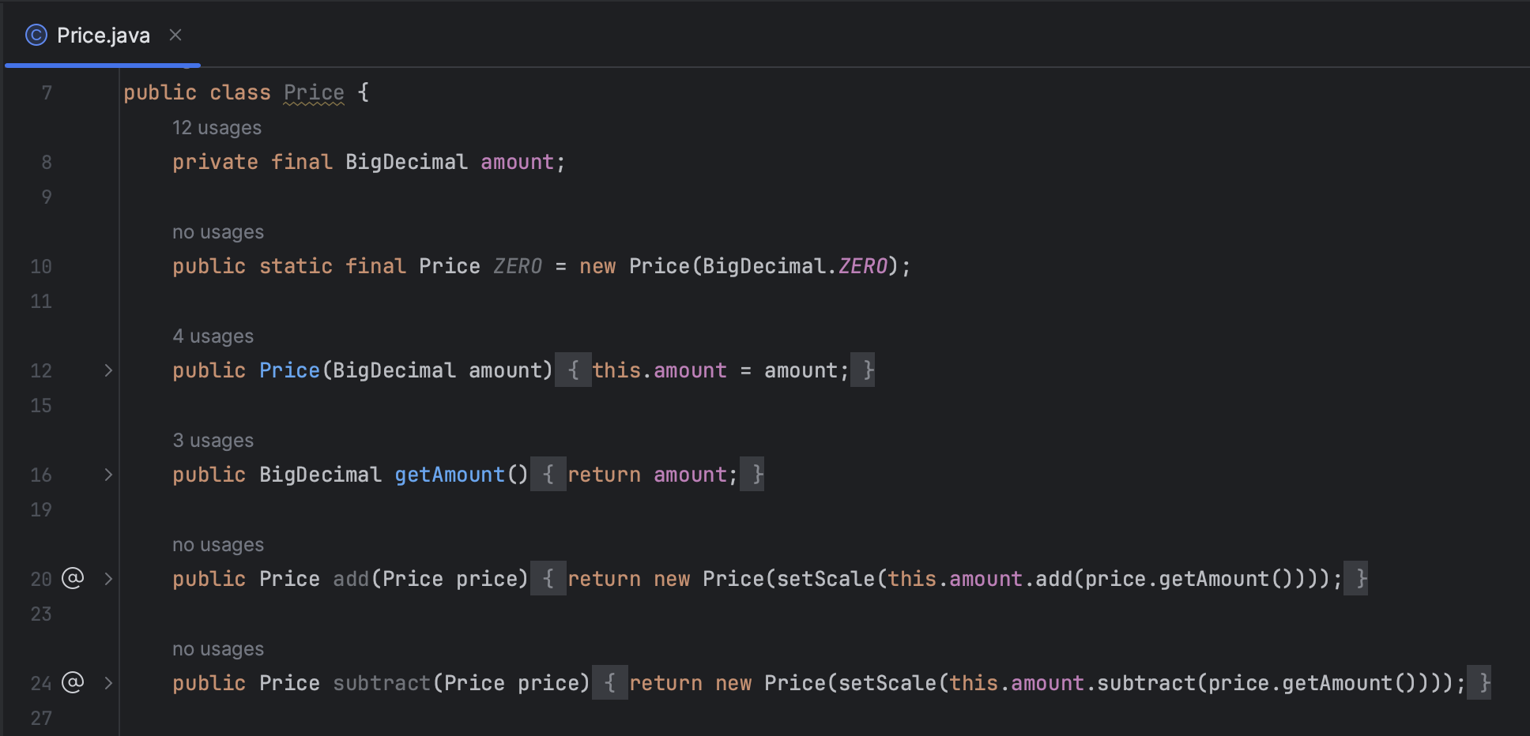
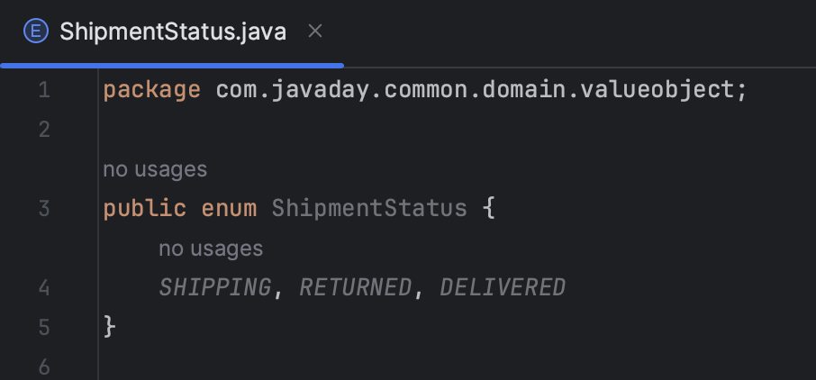
6. Sample Project Structure in Spring Boot
Value Object

Slide 18
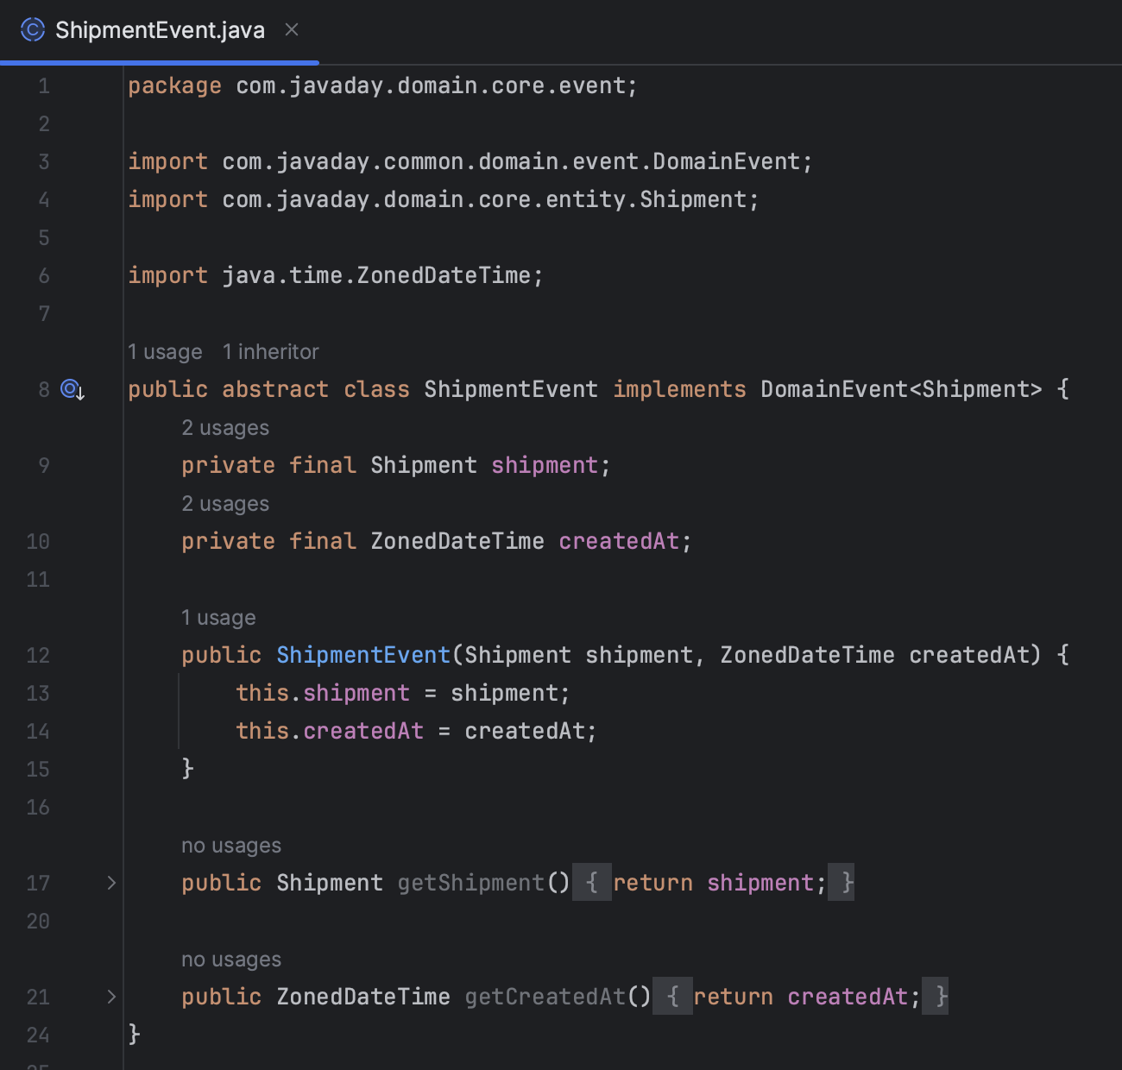
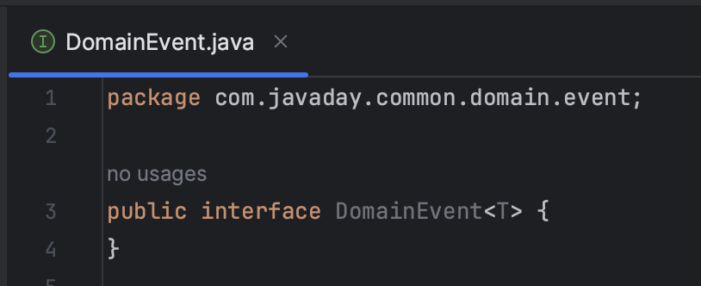
6. Sample Project Structure in Spring Boot
Domain Event

Slide 19
6. Sample Project Structure in Spring Boot
Rest ☺
messaging
application
persistence
MQ Requirements
Requests
application-services
Data Access Requirements
domain-core
Aggregate Root – Entity – Value Object - Event

